Slide 1
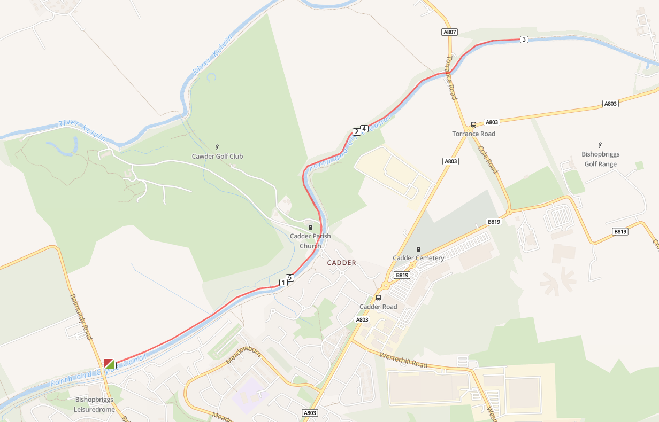
Canal Canter 6k Route Map and
Marshal Positions
6.😊
5.😊
4.😊
X.😊
3.😊
1.😊
😊2.

Slide 2
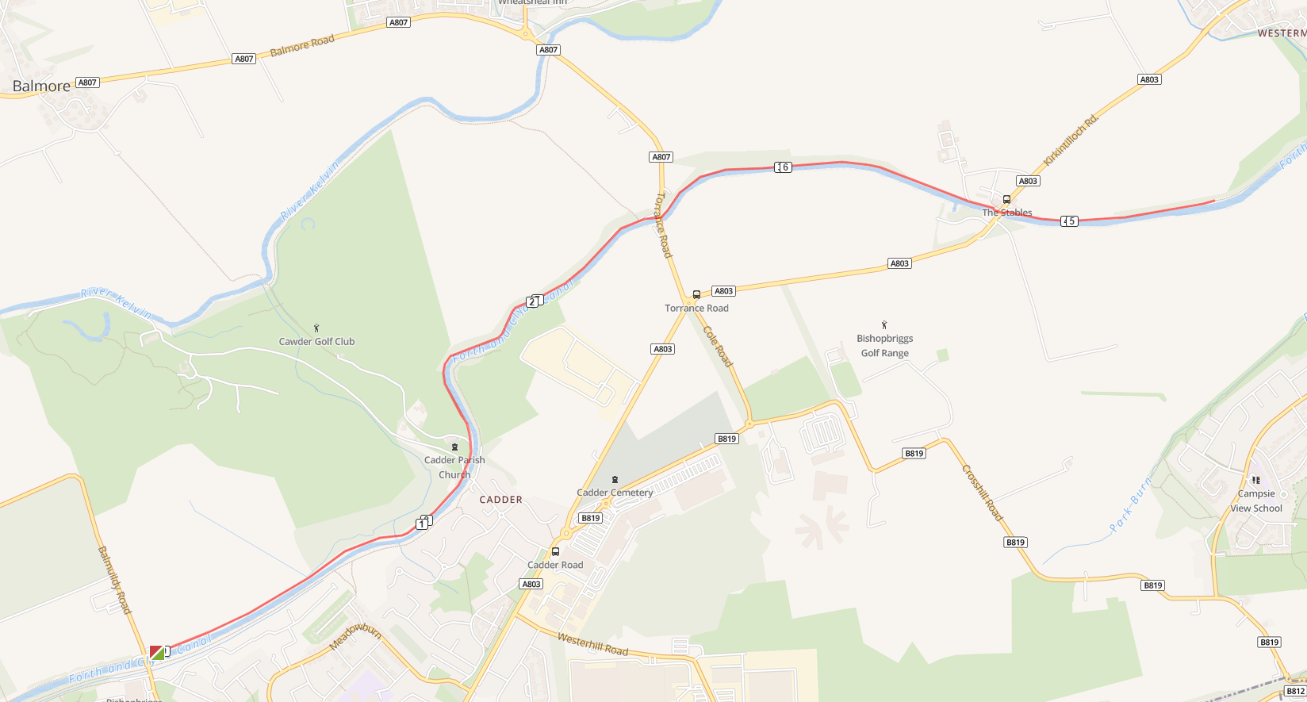
Canal Canter 9k Route Map and
Marshal Positions
6.😊
5.😊
7.😊
9.😊
4.😊
8.😊
X.😊
3.😊
1.😊
😊2.

